Slide 1





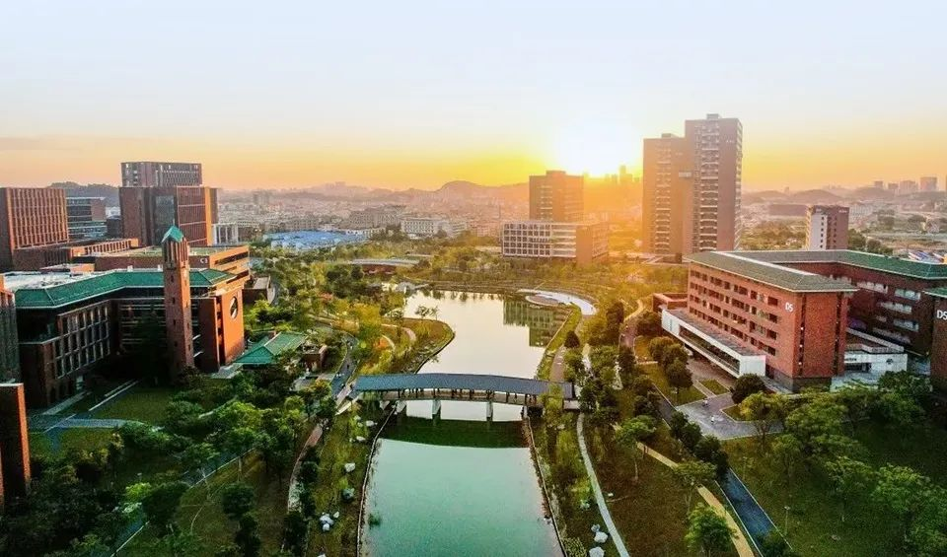
The 25th COTA International Conference of Transportation Professionals
Transportation · Artificial Intelligence (AI) · Energy
July 22nd – 25th, 2025 Guangzhou, China

